Slide 1
Data Access Reimagined
Grab with Gimel, Keep with Kylo
Deepak Chandramouli, Software Engineer, PayPal
Romit Mehta, Product Manager, PayPal

Slide 2


Presenters
Romit Mehta
Product Manager, Data Platform
Over 20 years in data & analytics
Gimel and PayPal Notebooks Product Manager @ PayPal
Linkedin: linkedin.com/in/romit-mehta
Deepak Chandramouli
Software engineer, big data
13 years in data engineering
Gimel software lead @ PayPal
LinkedIn: linkedin.com/in/deepakmc

Slide 3
Other PayPal sessions this week
PayPal gets to know its Customer through behavioral data
Wednesday @ 3:30PM room South Seas C
PayPal delivers NextGen Analytical Ecosystem with IFX 2.1 and TD 16.20
Wednesday @ 4:30PM room Jasmine B
PayPal Delivers Natural Language Analytics to Business Users with AI
Thursday @ 9:00AM room South Seas E
Data Access Reimagined: Grab with Gimel, Keep with Kylo
Thursday @ 10:00AM room South Seas A
PayPal enabling a new breed of analysts through Jupyter notebooks
Thursday @ 11:00AM room South Seas E
Notes:
This slide is for the second sessions, notice previous session fonts are Grey, current is Bold Black and future sessions are Black

Slide 4
About PayPal
Why Gimel
Analytics ecosystem @ PayPal
Gimel refresher
Data and analytics challenges
Gimel and Teradata in the big data ecosystem
PayPal’s Gimel use cases
Key features of Gimel’s Teradata API
Gimel’s roadmap
Questions

Slide 5
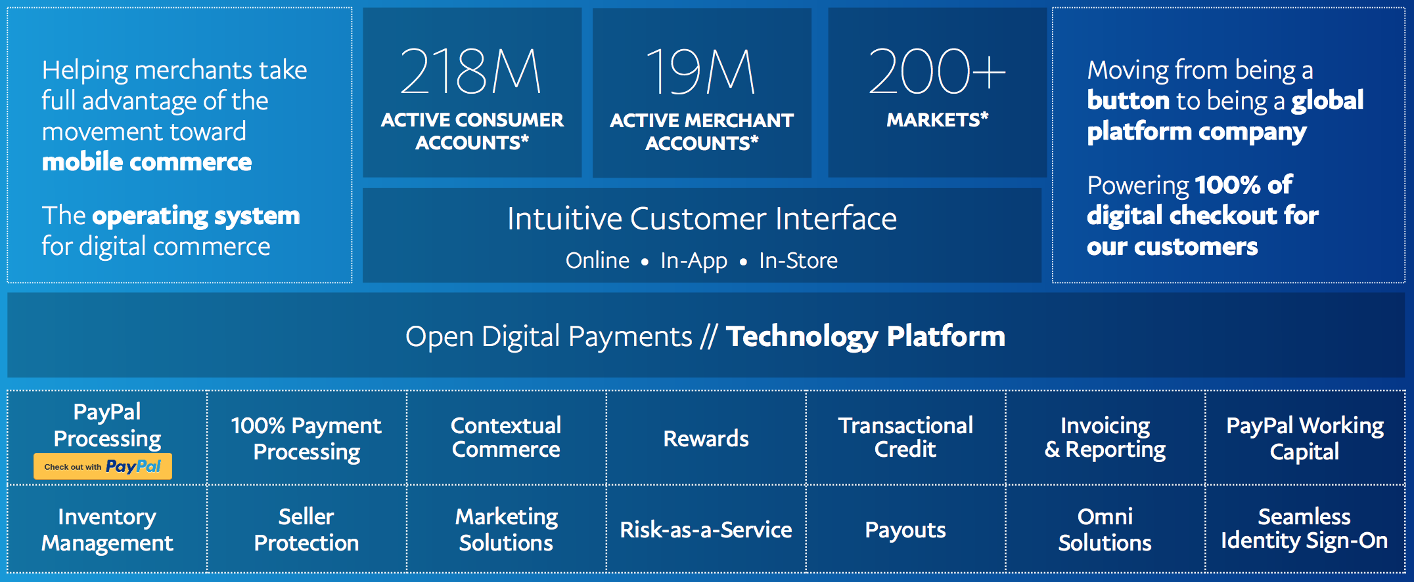
PayPal’s 2018 Business Summary
225M
19M+
200+
Notes:
Holly

Slide 6



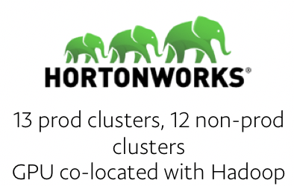


PayPal’s Scale: Technology
3 major data centers and a few others around the world
2 large Teradata clusters with 700+ nodes, 17.5 PB capacity
17.5+ PB
Teradata Data
10,000
Analytic Users
7,500,000
Queries Per Day
25 Hadoop clusters with 5,000+ nodes, 160 PB capacity
160+ PB
Data
75,000
Yarn Jobs Per Day

Slide 7
Why Gimel
Responding to analyst and data scientist challenges

Slide 8
Analytics @ PayPal

Slide 9

Gimel refresher
Single, unified API to connect to any data store
SQL access to any data store
Powered by Unified Data Catalog (UDC)
Interactive, batch and streaming mode support
SQL, Scala and Python support
Open sourced in April, 2018
gimel.io
UnifiedDataCatalog.io

Slide 10
Use case
”Yelp” analyst
Combine external business data with EDW
Load check ins, reviews and tips streaming in real time
Merge and enrich all these datasets for analytics
Create ”Offers” for customers
Copy enriched data to Hive for ML/AI
Analyst process
Integration: Bring external data into Teradata
Real-time processing: Load streaming data into Teradata
ETL: Run Teradata SQL processes to create a derived dataset
Site apps: Publish customized offers to Kafka
Data extracts: Create datasets for ML and load them into Hive

Slide 11




Use case challenges
Data Sources
Data Stores
Data Access

Slide 12
Gimel & Teradata
How the Yelp use case is simplified through Gimel

Slide 13
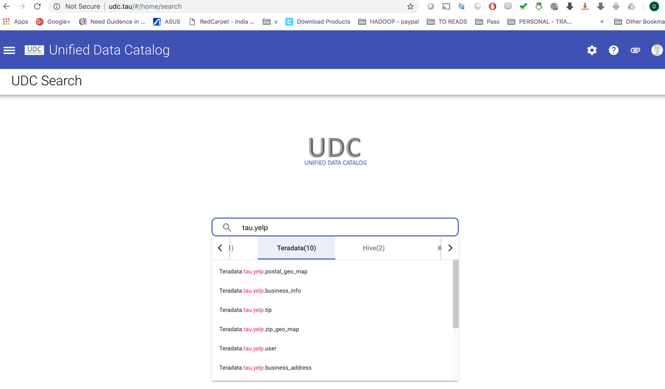
Unified Data Catalog
UnifiedDataCatalog.io

Slide 14
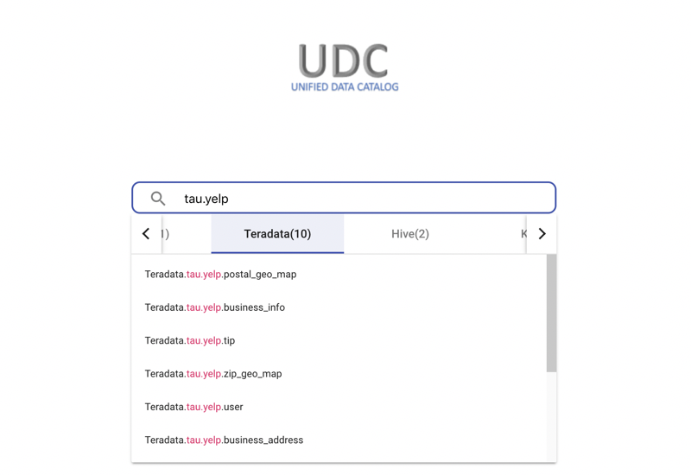
Search for datasets

Slide 15
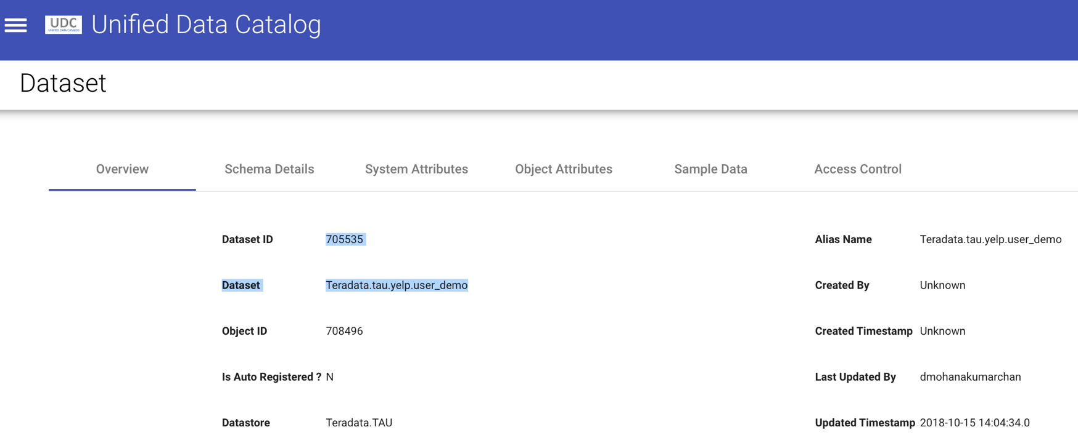
Dataset name

Slide 16
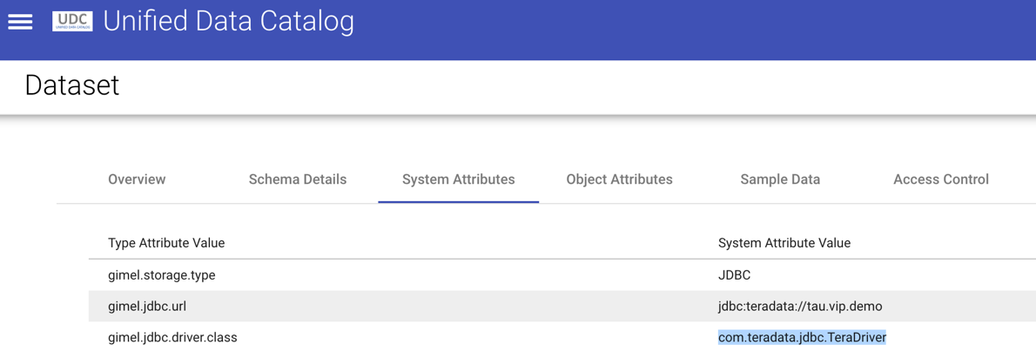
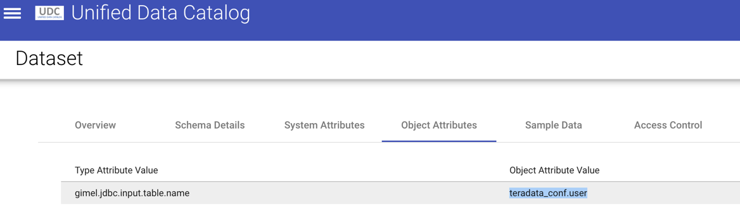
Review dataset attributes

Slide 17
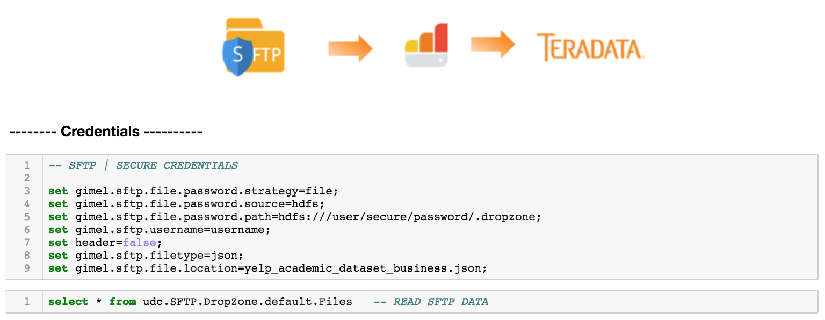
Get Yelp business files

Slide 18
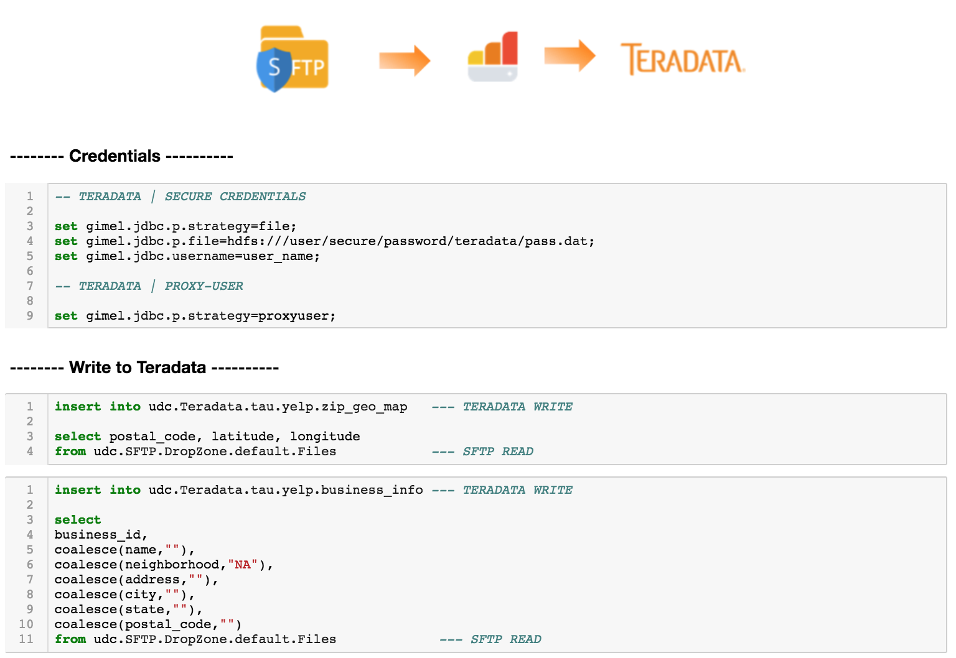
Load business data into Teradata

Slide 19
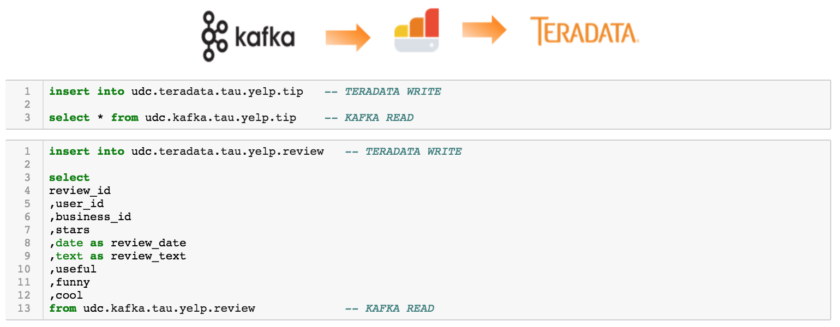
Load tips and reviews into Teradata

Slide 20
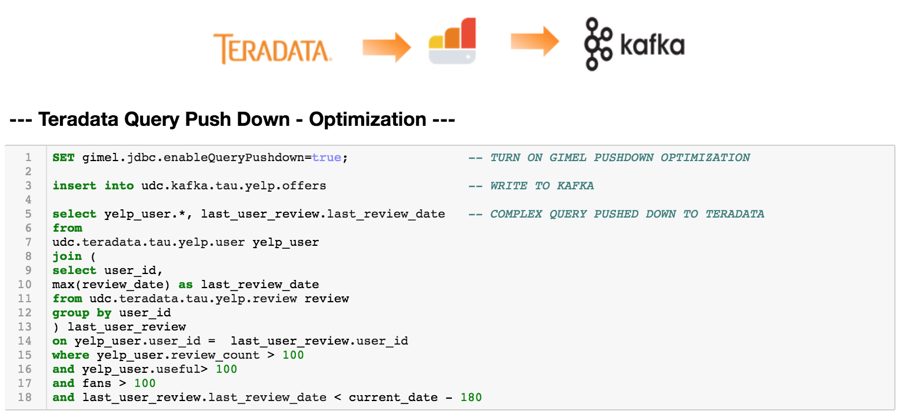
Publish offers data to Kafka

Slide 21
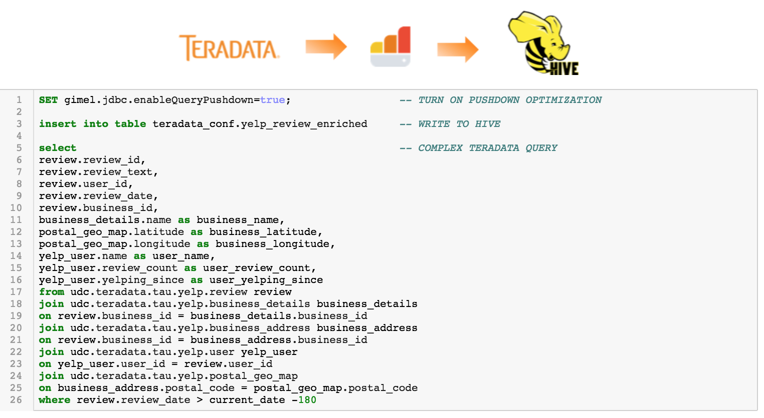
Load enriched data into Hive

Slide 22
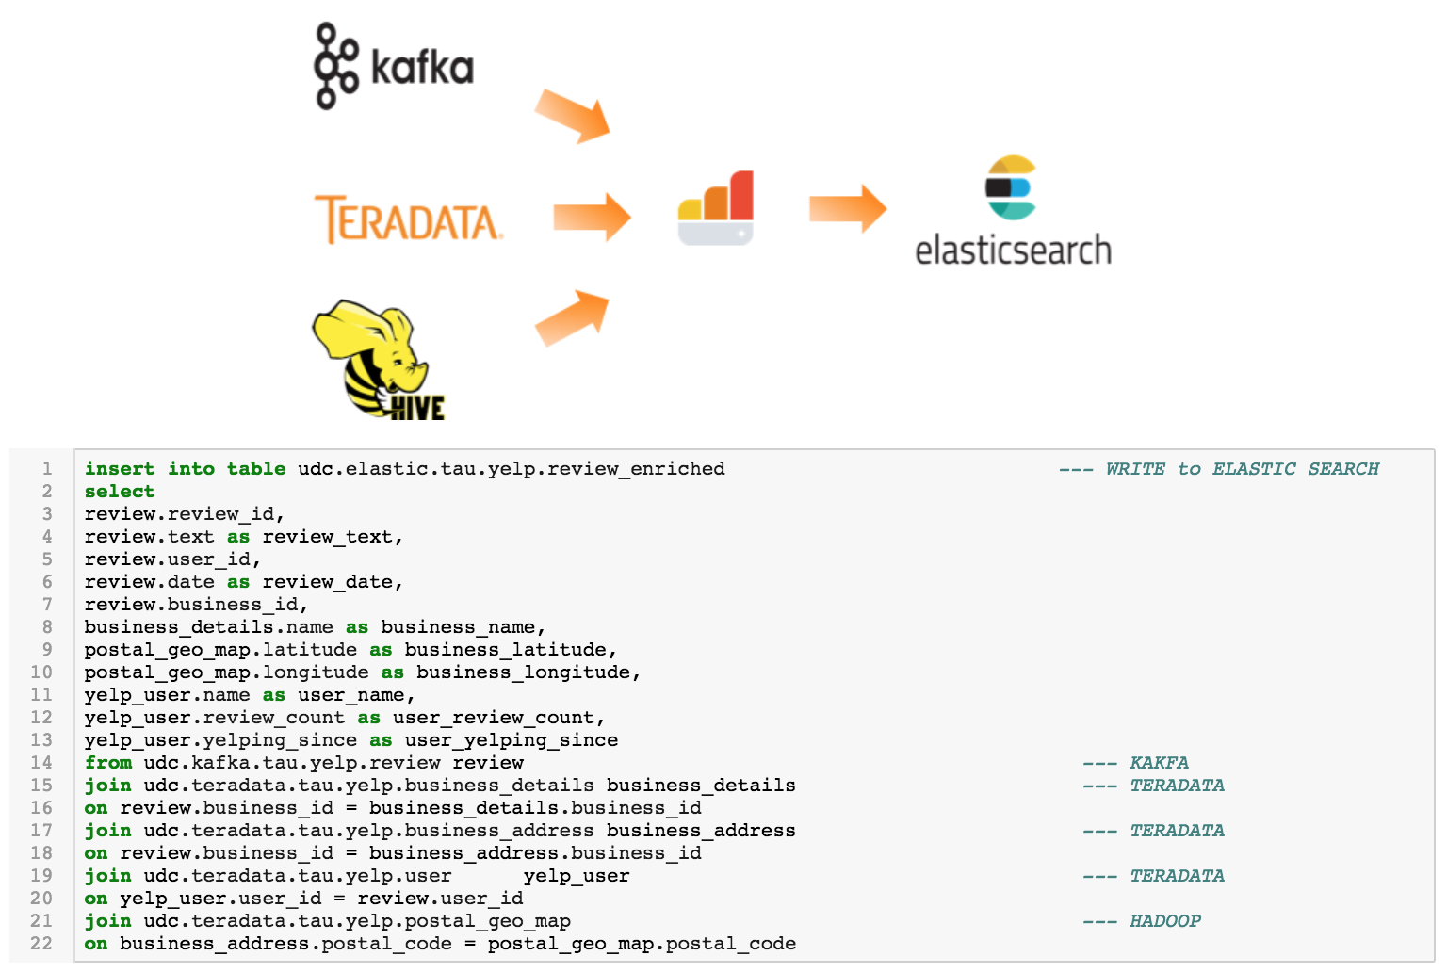
Complex SQL support

Slide 23
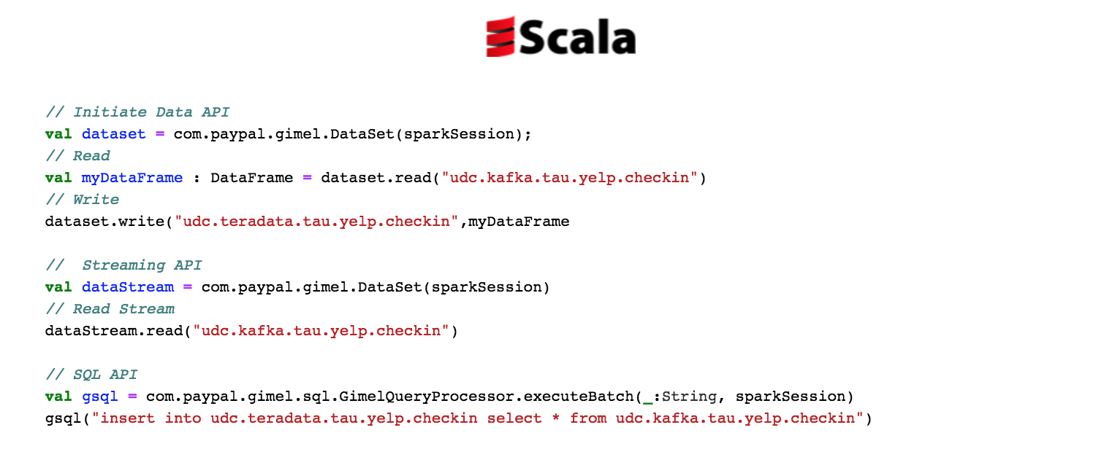
Gimel API with Scala

Slide 24
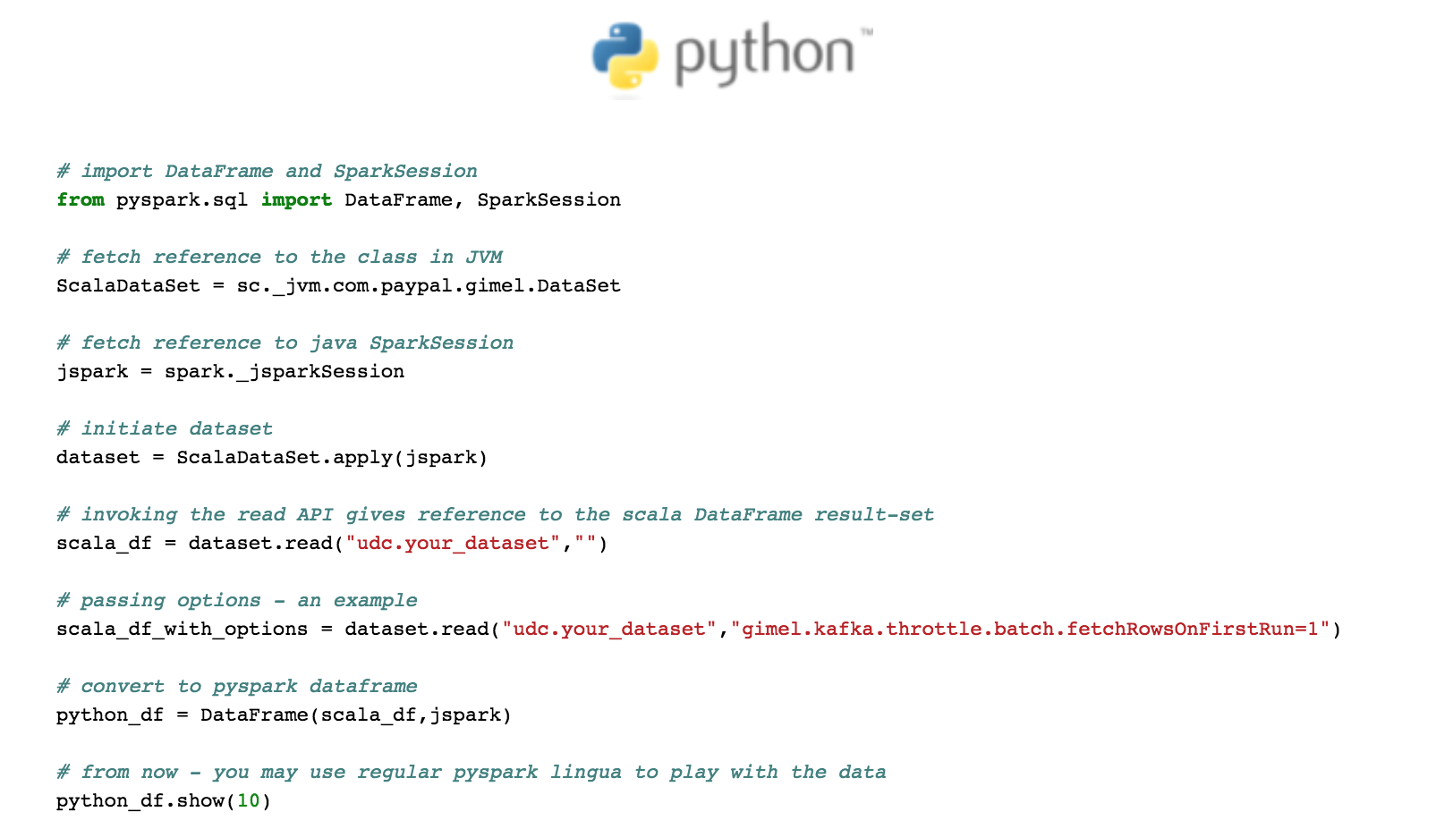
Gimel API with Python

Slide 25
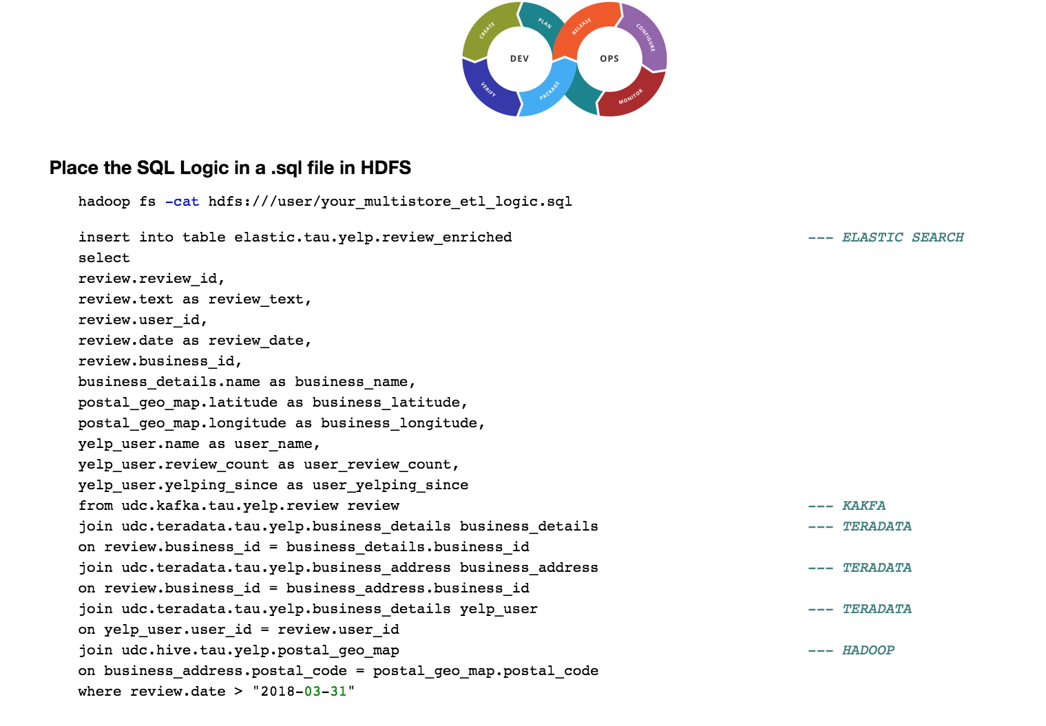
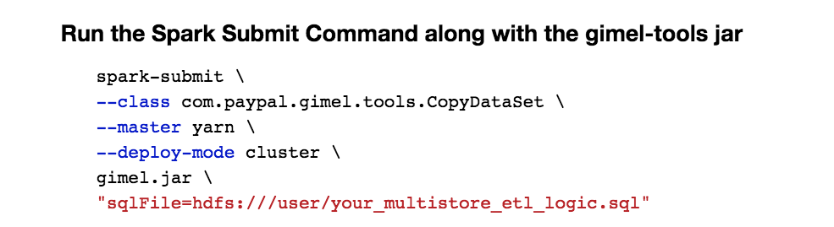
Seamless deployment process

Slide 26
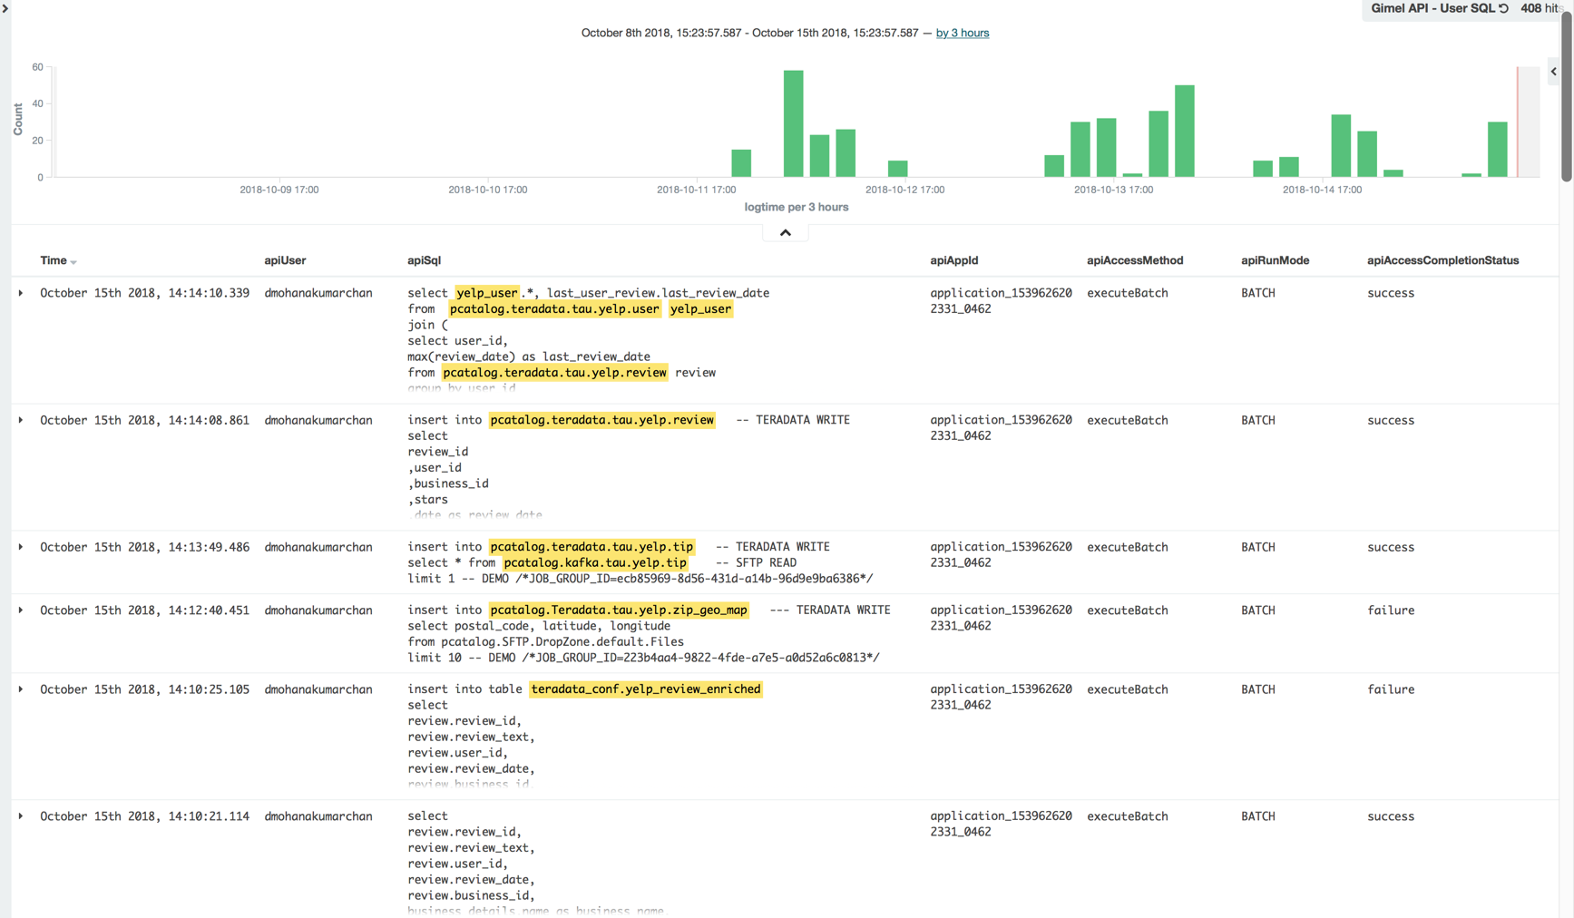
Automatic statement-level auditing

Slide 27
Gimel API & SQL
Solving modern day data challenges

Slide 28


Unified Data Catalog + Gimel

Slide 29

Endless Possibilities!

Slide 30
Supported Data Stores
Compatibility and version details on Github

Slide 31


Gimel Benefits
Unified Data Catalog
Convenient access to all datasets in the enterprise
Powers Gimel’s abstraction capabilities
Unified API and SQL
Avoid learning new semantics
Teradata integrated easily with rest of the big data ecosystem
Statement-level auditing
Notebooks Integration
Directly access Gimel through Jupyter notebooks with Gimel SQL (GSQL)

Slide 32
Gimel & Teradata
Key Features of Teradata API

Slide 33
Teradata Read
Decimal Types are now supported for parallelizing reads (Out of box support is only for Long Types)
Why - PayPal defined a lot of PI/UPI/Partitions as Decimal(38,0)
Parameterized switch between batch & fast-export
SET gimel.jdbc.read.type=FASTEXPORT
Select * from
udc.Teradata.prod.edw.txn b
Where txn_dt > current_date -10
Detailed image

Slide 34
Teradata Write
Parallel Fast loads (Native Implementation)
Avoid over-subscription to TD connections
Parameterized switch between batch & fast-load
Truncate Load option (Full Load) – All via SQL
SET gimel.jdbc.write.type=FASTLOAD;
SET gimel.jdbc.insertStrategy=FullLoad;
INSERT INTO udc.Teradata.prod.edw.txn_dly SELECT * FROM udc.Hive.cluster1.edw.txn
Where txn_dt = current_date
Detailed image

Slide 35
Teradata Query Push Down
Query Push Down works with DataSet Abstraction Layer – UDC
Huge Savings – IO / Network
SET gimel.jdbc.enableQueryPushdown=true;
Insert into HIVE
[ Select
a.cust_id, sum(b.txn_amt)
from udc.Teradata.prod.edw.cust a
Join udc.Teradata.prod.edw.txn b
Where a.cust_id = b.cust_id
And b.txn_dt > current_date -10 ]
Detailed image

Slide 36
Teradata Authentication
Today – without password not possible to connect to TD in spark world (hardcoding)
Introducing Password Strategy
File (pick from secure HDFS file)
Proxy-User (leverage TD Proxy)
SET gimel.jdbc.p.strategy=file;
SET gimel.jdbc.p.file=hdfs:///user/home/pass.dat;
INSERT INTO udc.Teradata.prod.edw.txn_dly
SELECT * FROM udc.kafka.cluster1.site.txns
SET gimel.jdbc.p.strategy=proxyuser;
INSERT INTO udc.Teradata.prod.edw.txn_dly
SELECT * FROM udc.kafka.cluster1.site.txns
Detailed image

Slide 37
Teradata – Benchmarking
Analysis
Benchmarking done using Yelp’s public datasets
Batch, Fast Load & Fast Export
Conclusion of benchmarking tests
<= 1 Million rows – Batch is preferred
> 1 Million, Fast Load & Fast Export fared better
Details
More info can be found at the Gimel Github Benchmarking Page

Slide 38
What’s next
Gimel’s roadmap

Slide 39
Gimel’s roadmap
Open source
Add Discovery Services to open source codebase
UDC Github
Expand footprint
Support for connectors to cloud data stores (gimel.io)
AWS
Google
Azure
Standalone Gimel
Expand standalone Gimel (try.gimel.io) to support cluster mode

Slide 40
Acknowledgements
Gimel team:
Anisha Nainani
Ayushi Agarwal
Baskaran Gopalan
Dheeraj Rampally
Deepak Chandramouli
Laxmikant Patil – core Teradata API developer laxpatil
Meisam Fathi Salmi
Prabhu Kasinathan
Praveen Kanamarlapudi
Romit Mehta
Thilak Balasubramanian

Slide 41
Questions?

Slide 42
1079
Follow Me
Twitter @
theromit, @deechandramouli
Questions/Comments
Email:
romehta@paypal.com
dmohanakumarchan@paypal.com

Slide 43
Appendix

Slide 44


& Anatomy of API
-- Establish 10 concurrent connections per Topic-Partition
set gimel.kafka.throttle.batch.parallelsPerPartition=10;
-- Fetch at max - 10 M messages from each partition
set gimel.kafka.throttle.batch.maxRecordsPerPartition=10,000,000;
%%gimel
insert into pcatalog.HIVE_dataset
partition(yyyy,mm,dd,hh,mi)
dataSet.write(”pcatalog.HIVE_dataset”,readDf , options)
select kafka_ds.*,gimel_load_id
,substr(commit_timestamp,1,4) as yyyy
,substr(commit_timestamp,6,2) as mm
,substr(commit_timestamp,9,2) as dd
,substr(commit_timestamp,12,2) as hh
from pcatalog.KAFKA_dataset kafka_ds
join default.geo_lkp lkp
on kafka_ds.zip = geo_lkp.zip
where geo_lkp.region = ‘MIDWEST’
dataSet.read(“dataSetName”,options)
dataSet.write(dataToWrite,”dataSetName”, options)
dataStream.read(“dataSetName”, options)
val dataSet : gimel.DataSet = DataSet(sparkSession)
val df1 = dataSet.read(“pcatalog.KAFKA_dataset”, options);
df1.createGlobalTempView(“tmp_abc123”)
Val resolvedSelectSQL = selectSQL.replace(“pcatalog.KAFKA_dataset”,”tmp_abc123”)
Val readDf : DataFrame = sparkSession.sql(resolvedSelectSQL);
kafkaDataSet.read(“dataSetName”,options)
hiveDataSet.write(dataToWrite,”dataSetName”, options)
storageDataStream.read(“dataSetName”, options)
val storageDataSet = getFromFactory(type=“Hive”)
CatalogProvider.getDataSetProperties(“dataSetName”)
val storageDataStream = getFromStreamFactory(type=“kafka”)
gimel.dataset.factory {
KafkaDataSet
ElasticSearchDataSet
DruidDataSet
HiveDataSet
AerospikeDataSet
HbaseDataSet
CassandraDataSet
JDBCDataSet
}
Metadata Services
gimel.datastream.factory {
KafkaDataStream
}
{
Core Connector Implementation, example – Kafka
Combination of Open Source Connector and
In-house implementations
Open source connector such as DataStax / SHC / ES-Spark
}

Slide 46

Catalog Provider – USER | HIVE | PCATALOG | Your Own Catalog
Metadata
Set gimel.catalog.provider=USER
CatalogProvider.getDataSetProperties(“dataSetName”)
Set gimel.catalog.provider=HIVE
CatalogProvider.getDataSetProperties(“dataSetName”)
CREATE EXTERNAL TABLE `pcatalog.test_table1`
(payload string)
LOCATION 'hdfs://tmp/'
TBLPROPERTIES (
"datasetName" -> "dummy",
"auto.offset.reset"-> "earliest",
"gimel.kafka.bootstrap.servers"-> "localhost:9092",
"gimel.kafka.avro.schema.source"-> "CSR",
"gimel.kafka.avro.schema.source.url"-> "http://schema_registry:8081",
"gimel.kafka.avro.schema.source.wrapper.key"-> "schema_registry_key",
"gimel.kafka.checkpoint.zookeeper.host"-> "zookeeper:2181",
"gimel.kafka.checkpoint.zookeeper.path"-> "/pcatalog/kafka_consumer/checkpoint",
"gimel.kafka.whitelist.topics"-> "kafka_topic",
"gimel.kafka.zookeeper.connection.timeout.ms"-> "10000",
"gimel.storage.type"-> "kafka",
"key.serializer"-> "org.apache.kafka.common.serialization.StringSerializer",
"value.serializer"-> "org.apache.kafka.common.serialization.ByteArraySerializer"
);
Spark-sql> Select * from pcatalog.test_table1
Scala> dataSet.read(”test_table1",Map("dataSetProperties"->dataSetOptions))
spark.sql("set gimel.catalog.provider=USER");
val dataSetOptions = DataSetProperties(
"KAFKA",
Array(Field("payload","string",true)) ,
Array(),
Map(
"datasetName" -> "test_table1",
"auto.offset.reset"-> "earliest",
"gimel.kafka.bootstrap.servers"-> "localhost:9092",
"gimel.kafka.avro.schema.source"-> "CSR",
"gimel.kafka.avro.schema.source.url"-> "http://schema_registry:8081",
"gimel.kafka.avro.schema.source.wrapper.key"-> "schema_registry_key",
"gimel.kafka.checkpoint.zookeeper.host"-> "zookeeper:2181",
"gimel.kafka.checkpoint.zookeeper.path"-> "/pcatalog/kafka_consumer/checkpoint",
"gimel.kafka.whitelist.topics"-> "kafka_topic",
"gimel.kafka.zookeeper.connection.timeout.ms"-> "10000",
"gimel.storage.type"-> "kafka",
"key.serializer"-> "org.apache.kafka.common.serialization.StringSerializer",
"value.serializer"-> "org.apache.kafka.common.serialization.ByteArraySerializer"
)
)
dataSet.read(”test_table1",Map("dataSetProperties"->dataSetOptions))
sql> set dataSetProperties={
"key.deserializer":"org.apache.kafka.common.serialization.StringDeserializer",
"auto.offset.reset":"earliest",
"gimel.kafka.checkpoint.zookeeper.host":"zookeeper:2181",
"gimel.storage.type":"kafka",
"gimel.kafka.whitelist.topics":"kafka_topic",
"datasetName":"test_table1",
"value.deserializer":"org.apache.kafka.common.serialization.ByteArrayDeserializer",
"value.serializer":"org.apache.kafka.common.serialization.ByteArraySerializer",
"gimel.kafka.checkpoint.zookeeper.path":"/pcatalog/kafka_consumer/checkpoint",
"gimel.kafka.avro.schema.source":"CSR",
"gimel.kafka.zookeeper.connection.timeout.ms":"10000",
"gimel.kafka.avro.schema.source.url":"http://schema_registry:8081",
"key.serializer":"org.apache.kafka.common.serialization.StringSerializer",
"gimel.kafka.avro.schema.source.wrapper.key":"schema_registry_key",
"gimel.kafka.bootstrap.servers":"localhost:9092"
}
sql> Select * from pcatalog.test_table1.
Set gimel.catalog.provider=PCATALOG
CatalogProvider.getDataSetProperties(“dataSetName”)
Metadata Services
Set gimel.catalog.provider=YOUR_CATALOG
CatalogProvider.getDataSetProperties(“dataSetName”)
{
// Implement this !
}

Slide 47
Datasets Challenges
47
Data access tied to compute and data store versions
Storage-specific dataset creation results in duplication and increased latency
Hard to find available data sets
No standards for on-boarding data sets for others to discover
No statistics on data set usage and access trends
No audit trail for dataset access

